Slide 1
Tableau Case Study
Taehyun Yoon

Slide 2
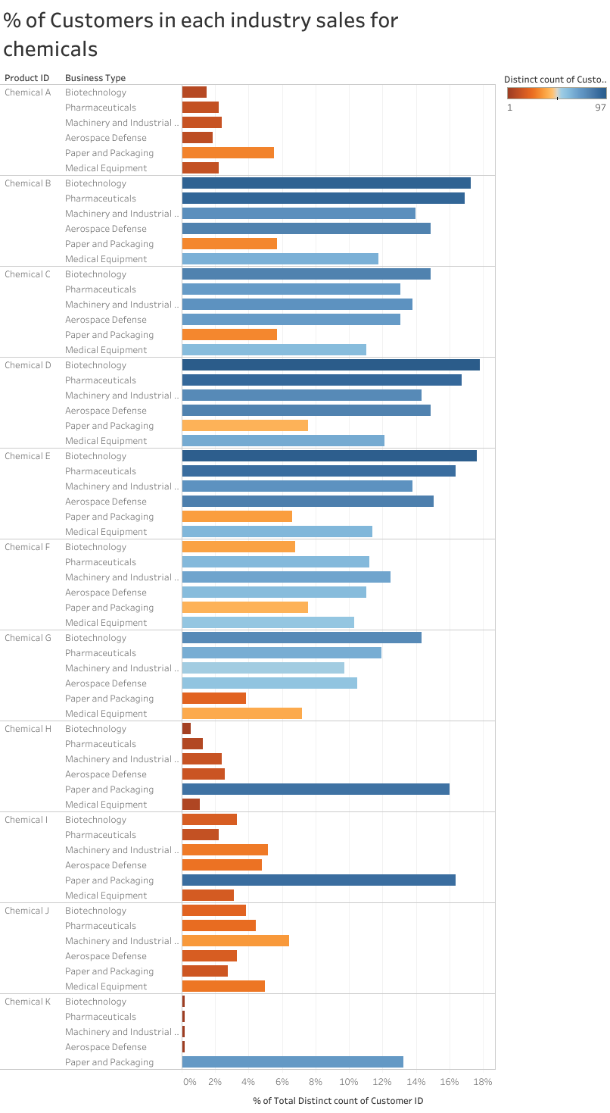

Slide 3
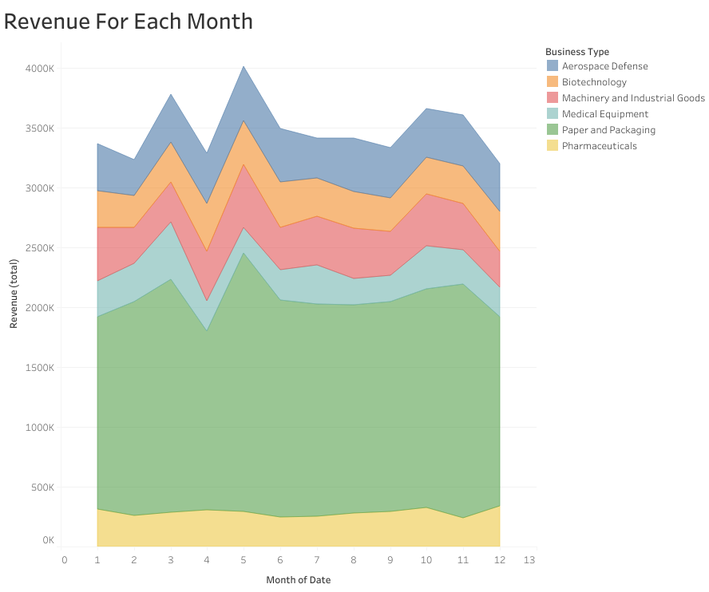

Slide 4
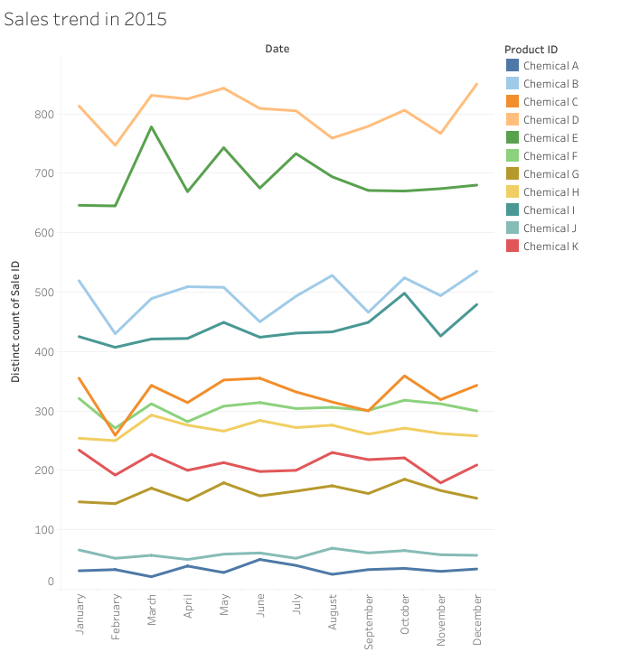

Slide 5


Slide 6
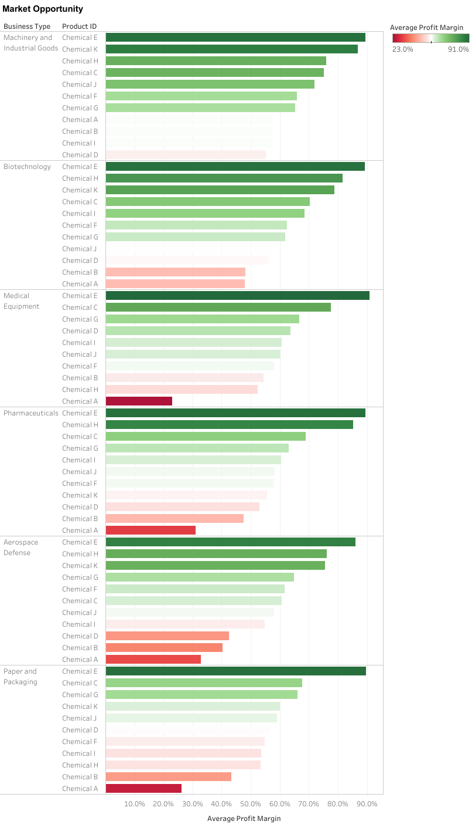

Slide 7
